Slide 1
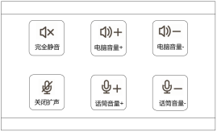
Wireless mic
Interactive host
2
3
5
7
Rear
Front
1
4
6
8
9
10
Control terminal
Courseware
Recording
Active Speaker
Configuration
OPS/PC

Slide 2
➊
➋
➌
➍
➎

Slide 3
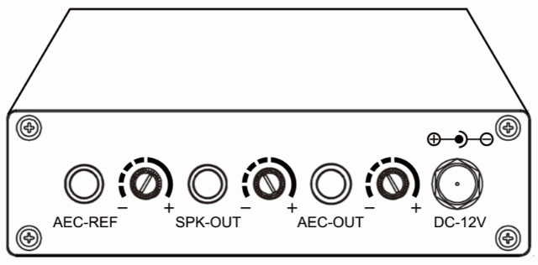

Slide 4
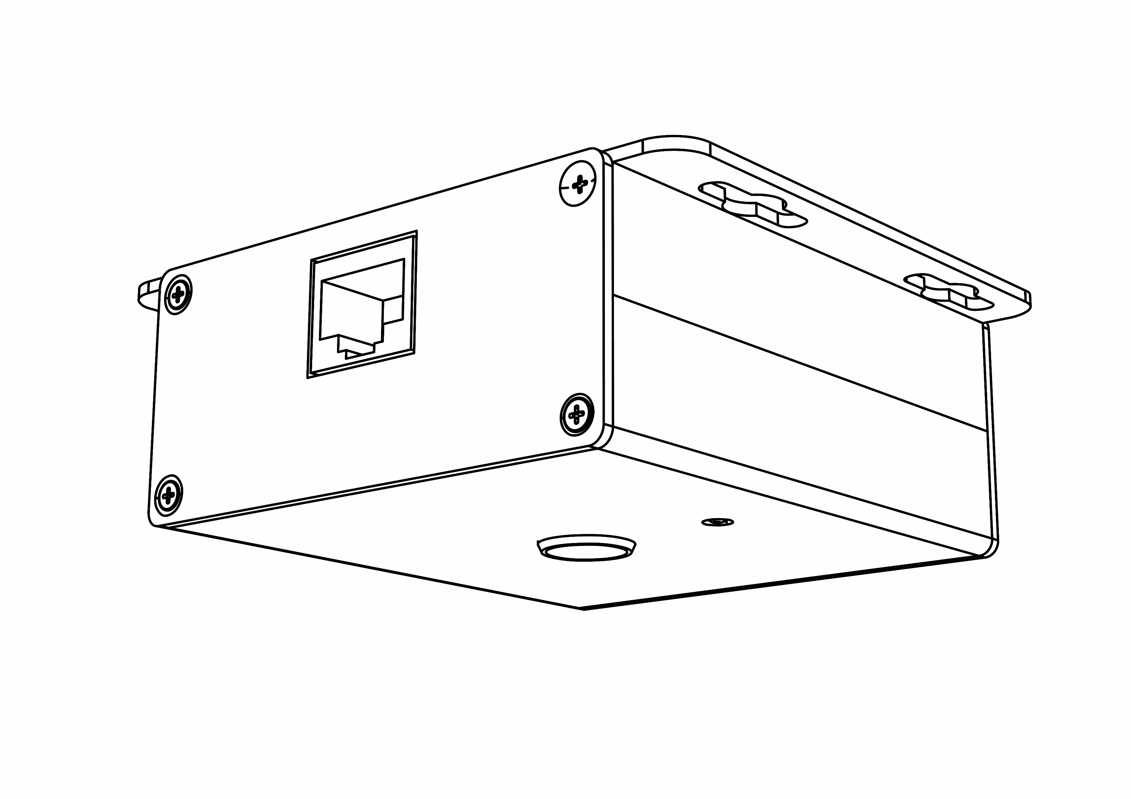
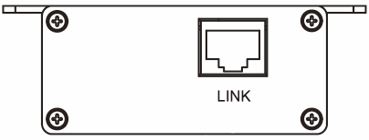
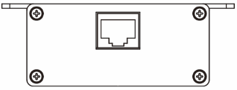

Slide 6
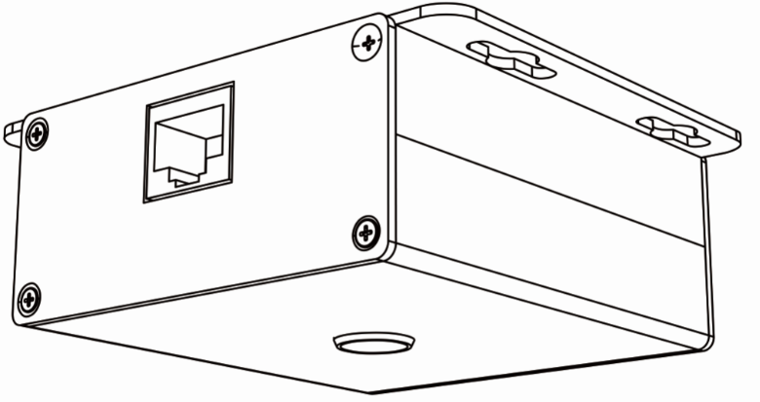
LINK
MIC-OUTPUT
Wireless mic
Interactive host
Rear
Front
Control terminal
Courseware
Recording
Active Speaker
Configuration
OPS/PC

Slide 7
