Slide 1
http://www.free-powerpoint-templates-design.com
HUE03T-4K
4K HDMI/ DisplayPort/ USB-C Switching CAT5e Extender

Slide 2
Agenda
01
Features
Key functions/ USB-C Alt mode PD/ Auto switching function
02
Applications
Case studies
03
Function Demonstration
Switching/ Blank/ USB to COM Port Command/ External Keypad

Slide 3
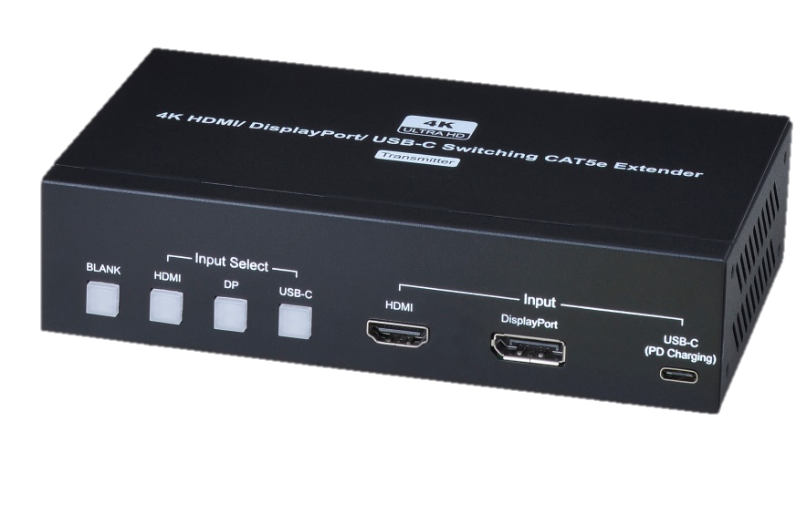
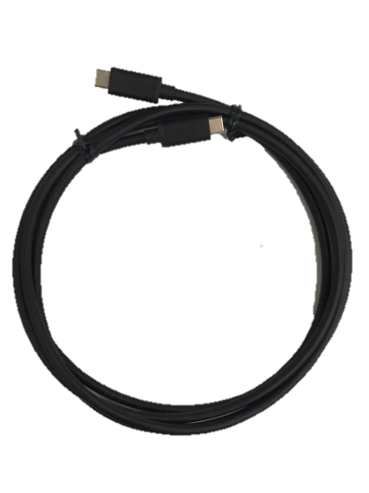
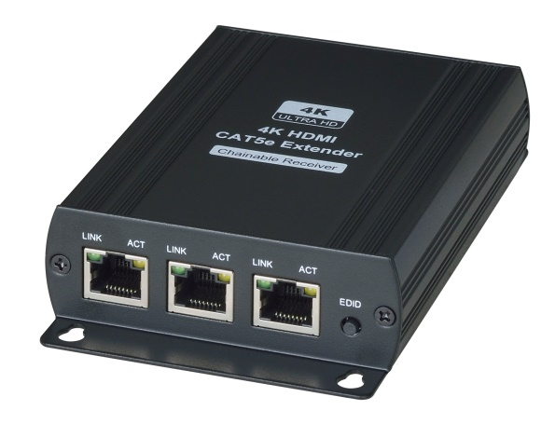
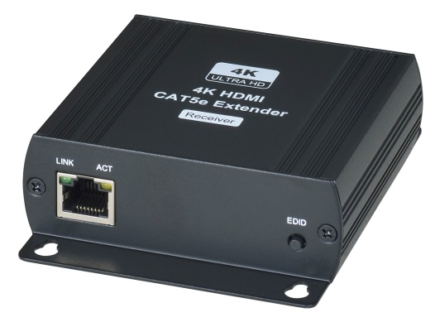
Presentation Solution
HUE03T-4K
HE03R-4K
HE03LR-4K
WUSBC-2M
Item No. | HUE03T-4K | HUE03-4K | WUSBC-2M
Package Contents | HUE03T-4K*1pcs | HUE03T-4K*1pcs HE03R-4K*1pcs | Thunderbolt3 USB-C to USB-C 20Gb/s Cable 2 Meters

Slide 4
3 in 1 out Auto switching CAT5e Extender
Support HDMI/ DP/ USB-C interfaces
Resolution up to 4K30Hz 4:4:4/ 1080p120Hz
Support Auto-switching & manual-switching
USB-C port supports PD (Power Delivery)
Support “Blank” function (Video Mute)

Slide 5
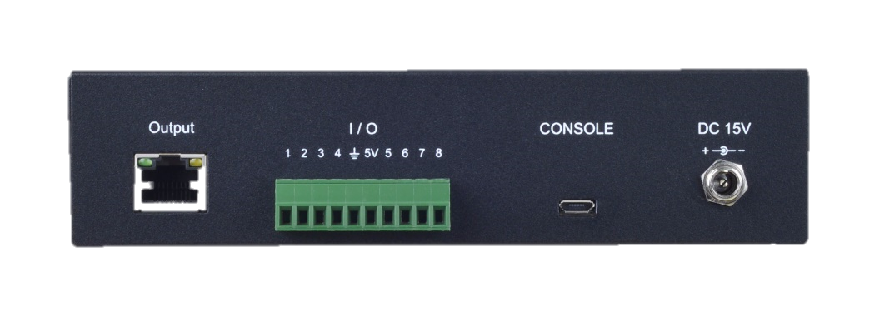
3 in 1 out Auto switching CAT5e Extender
Extendable up to 150M via CAT5e cable
Support contact closure for remote control pad
Could be integrated by other controllers
Support micro USB for serial commands
or Firmware update
Support power adapter locker

Slide 6
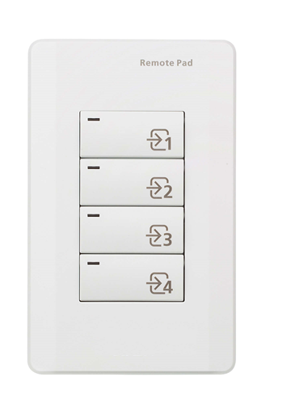
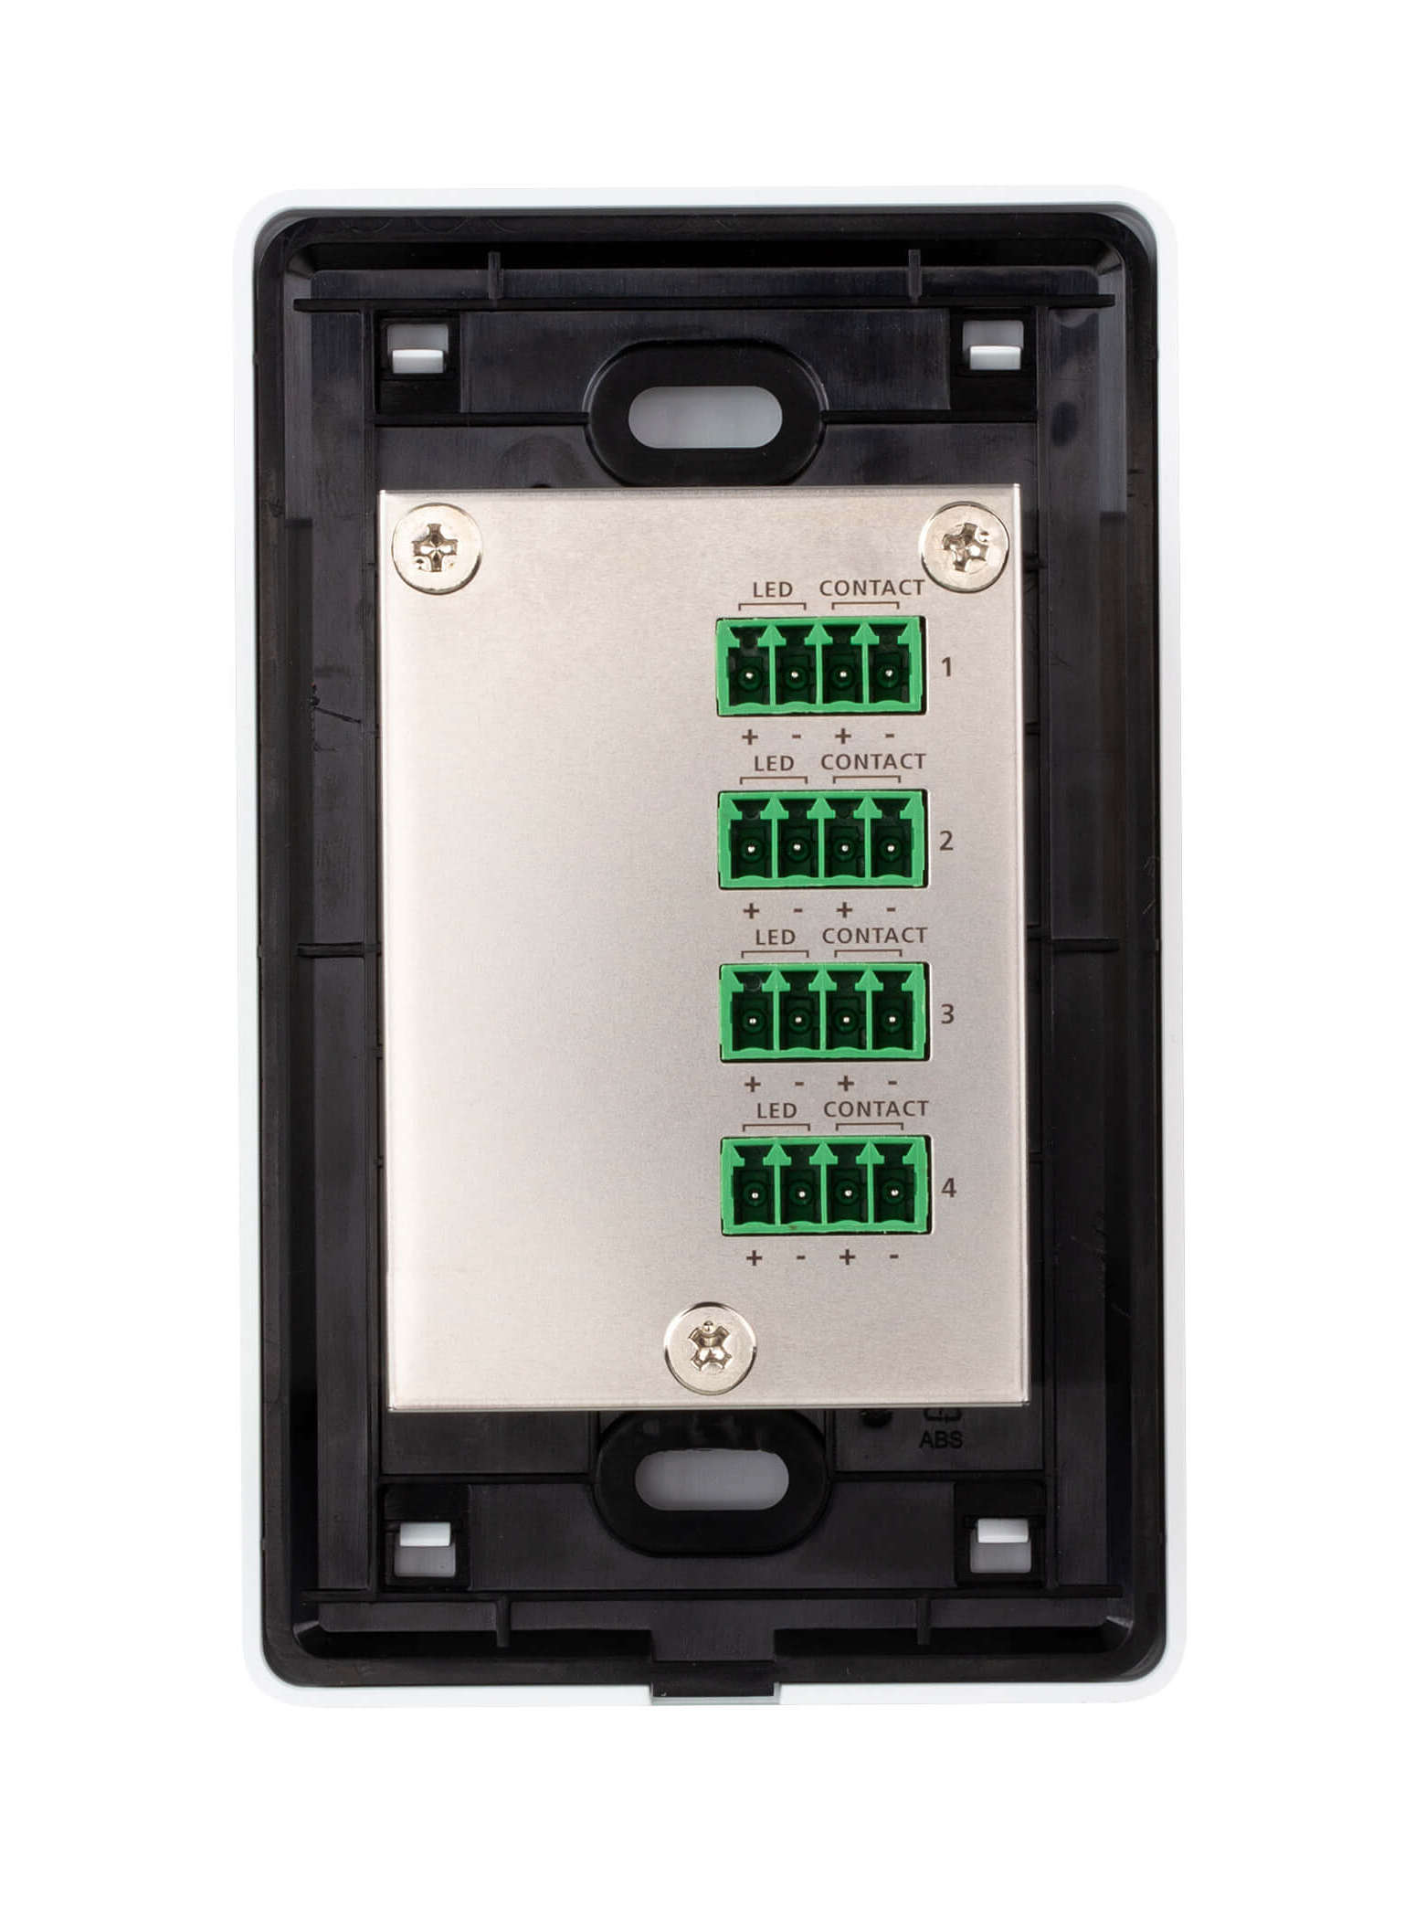
Contact Closure Remote Pad

Slide 7
Mounting Rack

Slide 8
Connection Diagram
Point to point

Slide 9
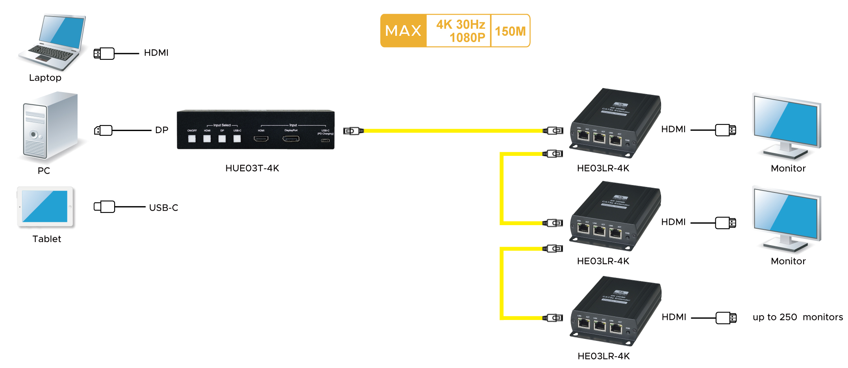
Connection Diagram
One to multiple

Slide 10
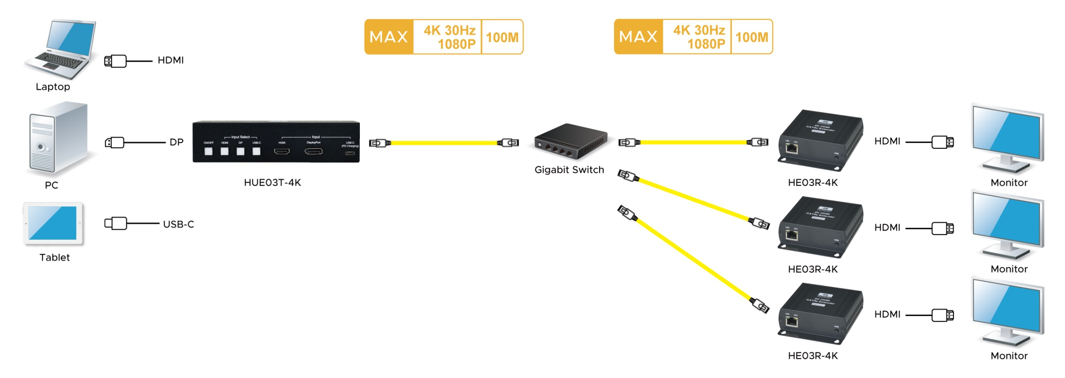
Connection Diagram
One to multiple via Ethernet Switch
*When connecting with Gigabit Switch, making sure to disable the EEE function

Slide 11
Application

Slide 12
Application

Slide 13
Support latest USB-C & USB-C PD
In the BYOD generation, the new devices, such as laptops, pads, and smart phones, has adopted the interface of USB-C to prepare for the trend. Support up to 40W power output to USB-C devices.
Transmission distance up to 150M
Exceed other brand’s transmission distance, the transmission distance up to 150M by CAT5e cable.
Fit Small to Large Conference Room
Leverage on the chainable receiver, it supports 1 in 250 out through CAT5e cable. It is hassle-free and saves the cost of splitters and cables.
SC&T’s Advantages

Slide 14
USB-C Devices
2 Billion
In 2019, 2 billion devices applied with USB-C
50 Million
In 2016, only 50 million devices applied with USB-C
The EU is moving towards mandating USB-C adoption on electronics.- Jan, 2020

Slide 15
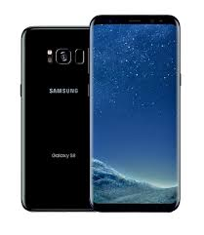
Who’s adopted USB-C?
SAMSUNG Galaxy S8
Pixel 4
iPad Pro
Apple MacBook
Nintendo Switch
Acer Swift 5

Slide 16
USB-C
PD( Power delivery): DC5V 3A(15W)、DC15V 2.6A (39W)
PD( Power delivery): Chargeable even displaying HDMI or DisplayPort source
DP Alt Mode: DisplayPort Alternate Mode over USB-C (No data transmittable)
USB-C cable: Support DP Alt mode, E-marker, USB3.2 standard cable, Thunderbolt 3

Slide 17
THANK YOU
Get your best Quote!

Slide 18
Auto-switching
In the Auto Switching mode, HUE03T-4K will detect connected input port and automatically switch to the detected source.
When fail to display the selected source in 6 secs, a connected source will automatically display instead.
When all sources are connected with HUE03T-4K, the last connected source will display.
To manually switch to a source in auto switching mode, the auto switching function will temporarily shutdown for 30 secs.
To manually switch to a source in auto switching mode, please wait for approximately 9 secs to display the selected source.
Auto Switching Priority: HDMI→DP→USB-C
* Turn on/ off the Auto Switching function via「 Front Panel 」or「 USB to Serial COM Port 」

